Slide 1
If condition

Slide 2
If condition
REFERENCES
https://youtu.be/qmHE9QISuVQ
https://youtu.be/F56Bo4I0GhA
https://youtu.be/taov2H_-nlU

Slide 3
If condition
Normally, statements in a program are executed one after the other in the order in which they’re written
This is called sequential execution.
So how can we choose specific statements to execute and other not?
Here comes the answer
The control statements are categorized in almost three groups:
1 - Selection control statements.
2 - Repetition control statements
3 – Jump statements
We will use the selection control statements to solve our problem.

Slide 4
If condition
Selection statements are used to choose among alternative courses of action.
For example
Suppose the passing mark on an exam is 50.
The pseudocode statement :
If student’s mark is greater than or equal to 50 Then
Print “Passed”.

Slide 5
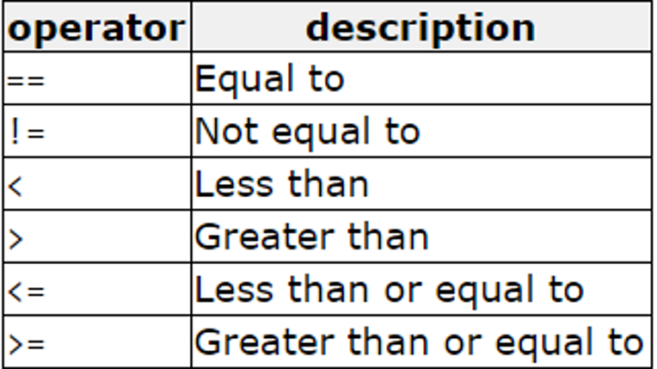
If condition
1) Relational Operators

Slide 6
If condition
Our computer use 0 for saying that expression is FALSE or 1 for saying that expression is TRUE
Let’s see some examples
Cout<<3>5; → Is 3 greater than 5? False so it’s like printing “0”
Cout<<5>3; → Is 5 greater than 3? True so it’s like printing “1”
Cout<<3==3; → Is 3 equal 3? True so it’s like printing “1”
Let’s see the code and it’s result

Slide 7
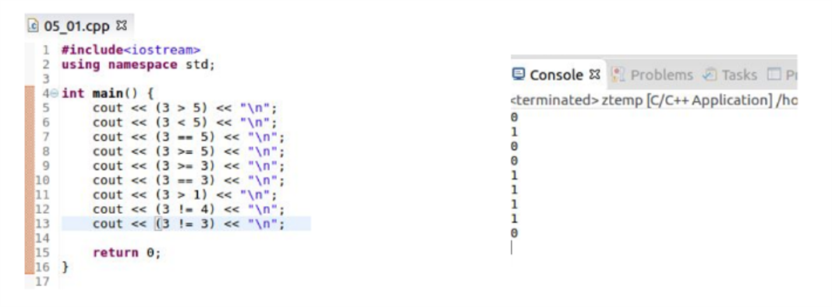
If condition

Slide 8
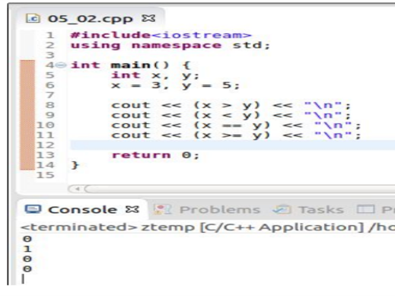
If condition
We can also use variables

Slide 9
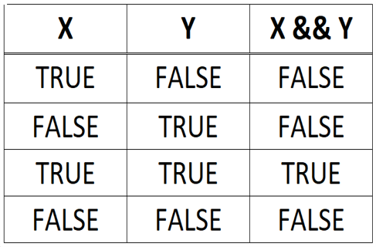
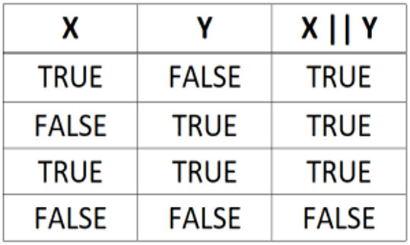
If condition
2)Logical Operators
&& (AND)
|| (OR)

Slide 10
If condition
1)And logical operators
Let say Mostafa is 30 years old man and his salary = 7000
Mostafa > 25 years and salary < 8000? True
Mostafa > 27 years and salary > 9000? False
Mostafa > 35 years and salary < 8500? False
Mostafa > 35 years and salary > 9000? False
Summary
Only 1 case is true when both conditions are true

Slide 11
If condition
2)OR logical operators
Let say Mostafa is 30 years old man and his salary = 7000.
Mostafa > 25 years or salary < 8000? True
Mostafa > 27 years or salary > 9000? True
Mostafa > 35 years or salary < 8500? True
Mostafa > 35 years or salary > 9000? False
Summary
Only 1 case is false when both conditions are false.

Slide 12
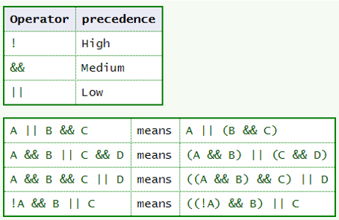
If condition
Precedence of logical operators
Precedence: means what to apply first. Here we apply the negation (NOT) then AND, and finally OR.
Advanced
What if I want to force specific priority? Use (), Every group of () is computed first.

Slide 13
If condition
Mixing Logical Operators in C++
Let say Mostafa is 30 years old, salary = 7000 and weight = 110 kg
Mostafa > 35 years or salary > 6000 or weight > 200kg? True
Mostafa > 35 years and salary > 6000 or weight > 200kg? False
Reduce every subgroup of ANDS first
F or T or … ⇒ T
F and … or F ⇒ F

Slide 14
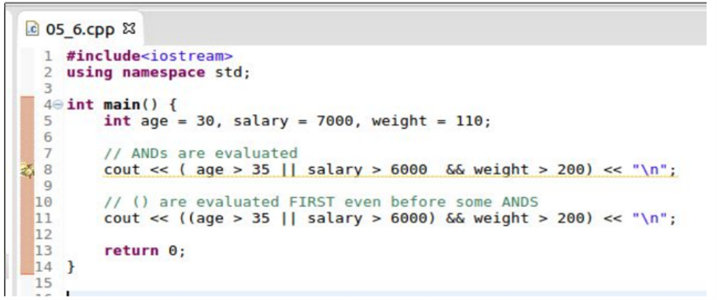
If condition
GUESS THE OUTPUT

Slide 15
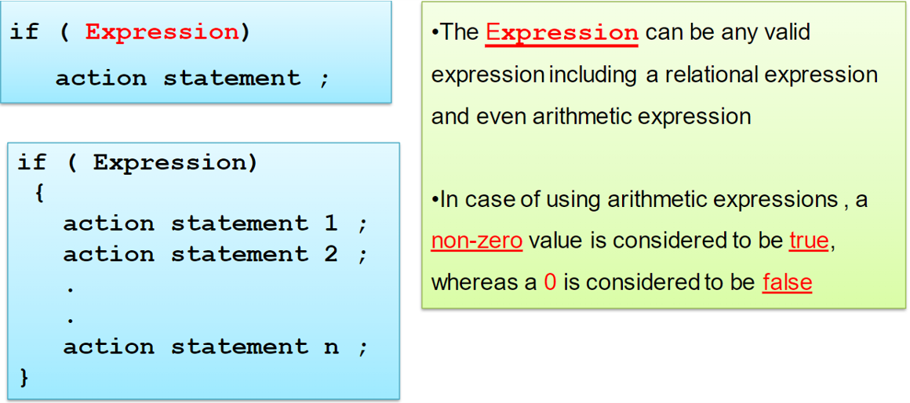
If condition
In c++ the syntax of IF statement is
if ( grade >= 50 ) cout<<"Passed”;

Slide 16

If condition
Write a program that accept an integer
from the user and in case this integer is even print out the following message “Number is even “ .
#include <bits/stdc++.h> using namespace std ; int main() { int number ; cin >> number; if (number % 2 == 0) cout << "Number is even\n"; return 0 ; }

Slide 17
If condition
IF .. Else Statement
The IF…Else selection statement allows you to specify that there is a course of actions are to be performed when the condition is true and another course of actions will be executed when the condition is false.
For example
The pseudocode statement
If student’s mark is greater than or equal to 50
Print “Passed”
Else
Print “Failed”

Slide 18
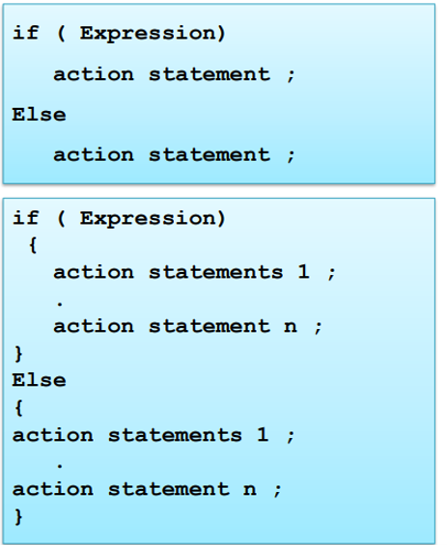
If condition
In C++ The syntax for the IF…Else statement
#include <bits/stdc++.h> using namespace std ; int main() { int grade ; cin >> grade; if ( grade >= 50 ) cout <<"Passed\n"; else cout <<"failed\n"; return 0 ; }

Slide 19
If condition
Exercise
write a program that accept an integer from the user and print out whether it is Positive or Negative number

Slide 20
If condition
ANSWER
#include<iostream> using namespace std; int main(){ int x; cin>>x; if(x>0) cout<<"positive"; else cout<<"negative"; return 0; }

Slide 21
If condition
If-else if statement
if (condition)
{
//Statements
}
else if (condition) {
//Statements
}
else {
//Statements
}

Slide 22
If condition
Example
write a program that ask the user to Enter2 numbers and print out whether they are equal or there is one which is greater than the other
using namespace std;
int main() {
int num1, num2;
cout << "Enter Number 1 , Number2 \n";
cin >> num1 >> num2;
if (num1 == num2)
cout << "Both Are Equal \n";
else if (num1 > num2)
cout << "Number 1 is greater than number 2 \n";
else
cout << "Number 2 is greater than number 1 \n";
}

Slide 23
If condition
practice
print out the student grade according to the following formulas
A for exam marks greater than or equal 90 and less than or equal 100 ,
B for exam marks greater than or equal 80 and less than 90 ,
C for exam marks than or equal to 70 and less than 80 ,
D for exam marks than or equal to 60, and less than 70 ,
F for all other marks

Slide 24
If condition
Answer
#include<iostream> using namespace std; int main(){ float grade; cin>>grade; if(grade>=90&&grade<=100) cout<<"A"; else if(grade>=80&&grade<90) cout<<"B"; else if(grade>=70&&grade<80) cout<<"C"; else if(grade>=60&&grade<70) cout<<"D"; else cout<<"F"; return 0; }

Slide 25
If condition
Practice
Given two numbers and a sign between them which will indicate if the user want the addition, subtraction, division or multiplication of these two numbers
find the value of the answer.
Inputs ⇒ outputs
7 + 55 ⇒ 62
7 * 10 ⇒ 70

Slide 26
If condition
Answer
#include<iostream> using namespace std; int main(){ float num1,num2; char op; cin>>num1>>op>>num2; if(op=='+') cout<<num1+num2; else if(op=='-') cout<<num1-num2; else if(op=='/'){ if(num2==0) cout<<"cant be solved"; else cout<<num1/num2;} else cout<<num1*num2; return 0; }

Slide 27
If condition
To be more advanced
INCREMENT & DECREMENT OPERATOR ++,--
C++ also provides increment and decrement operators ++ and -- respectively.
++ increment the value by 1
-- decrement the value by 1
a++ is like a=a+1;
a-- is like a=a-1;

Slide 28
If condition
int a=5;
a++;//a=6
--a;//a=5
int b=6;
++b;//b=7
b=18;
b--;//b=17
--a;//a=5

Slide 29
If condition
Pre,post- Increment & pre,post-decrement Operator ++,--
Pre-increment operator: operator used to increment the value of a variable before using it in an expression. In the Pre-Increment, value is first incremented and then used inside the expression.
int x=5;
a=++x;
cout<<a;//a=6
cout<<x; //x=6
int b=7;
int c=--b;
cout<<c;//c=6
cout<<b;//b=6

Slide 30
If condition
Post-increment operator: operator used to increment the value of the variable after executing the expression completely in which post-increment is used.
int x=5;
a=x++;
cout<<a;
cout<<x;
a=5
x=6
int b=7;
int c=b--;
cout<<c; cout<<b;
c=7
b=6

Slide 31
If condition
GUESS THE OUTPUT
#include<iostream>
using namespace std;
int main() {
int x, y = 2;
if(x = y % 2)
cout << 1;
else
cout << 0;
return 0;
}

Slide 32
If condition
GUESS THE OUTPUT
#include<iostream>
using namespace std;
int main() {
int x = 0;
if(++x)
cout << 1;
else
cout << 0;
return 0;
}

Slide 33
If condition
GUESS THE OUTPUT
#include<iostream>
using namespace std;
int main() {
int x = 0;
if(x++)
cout << 1;
else
cout << 0;
return 0;
}

Slide 34
If condition
GUESS THE OUTPUT
#include<iostream>
using namespace std;
int main() {
int x = 1, y = 0, z = 1;
if(++x && y++ && z)
cout << 1;
else
cout << 0;
return 0;
}

Slide 35
If condition
GUESS THE OUTPUT
OUTPUT=0
OUTPUT=1
OUTPUT=0
OUTPUT=0

Slide 36
Thank You

